Slide 1





ABOUT NIST
CORPORATE HSE TRAINING
SAADHANA HEALTH AND SAFETY

Slide 2


Slide 3
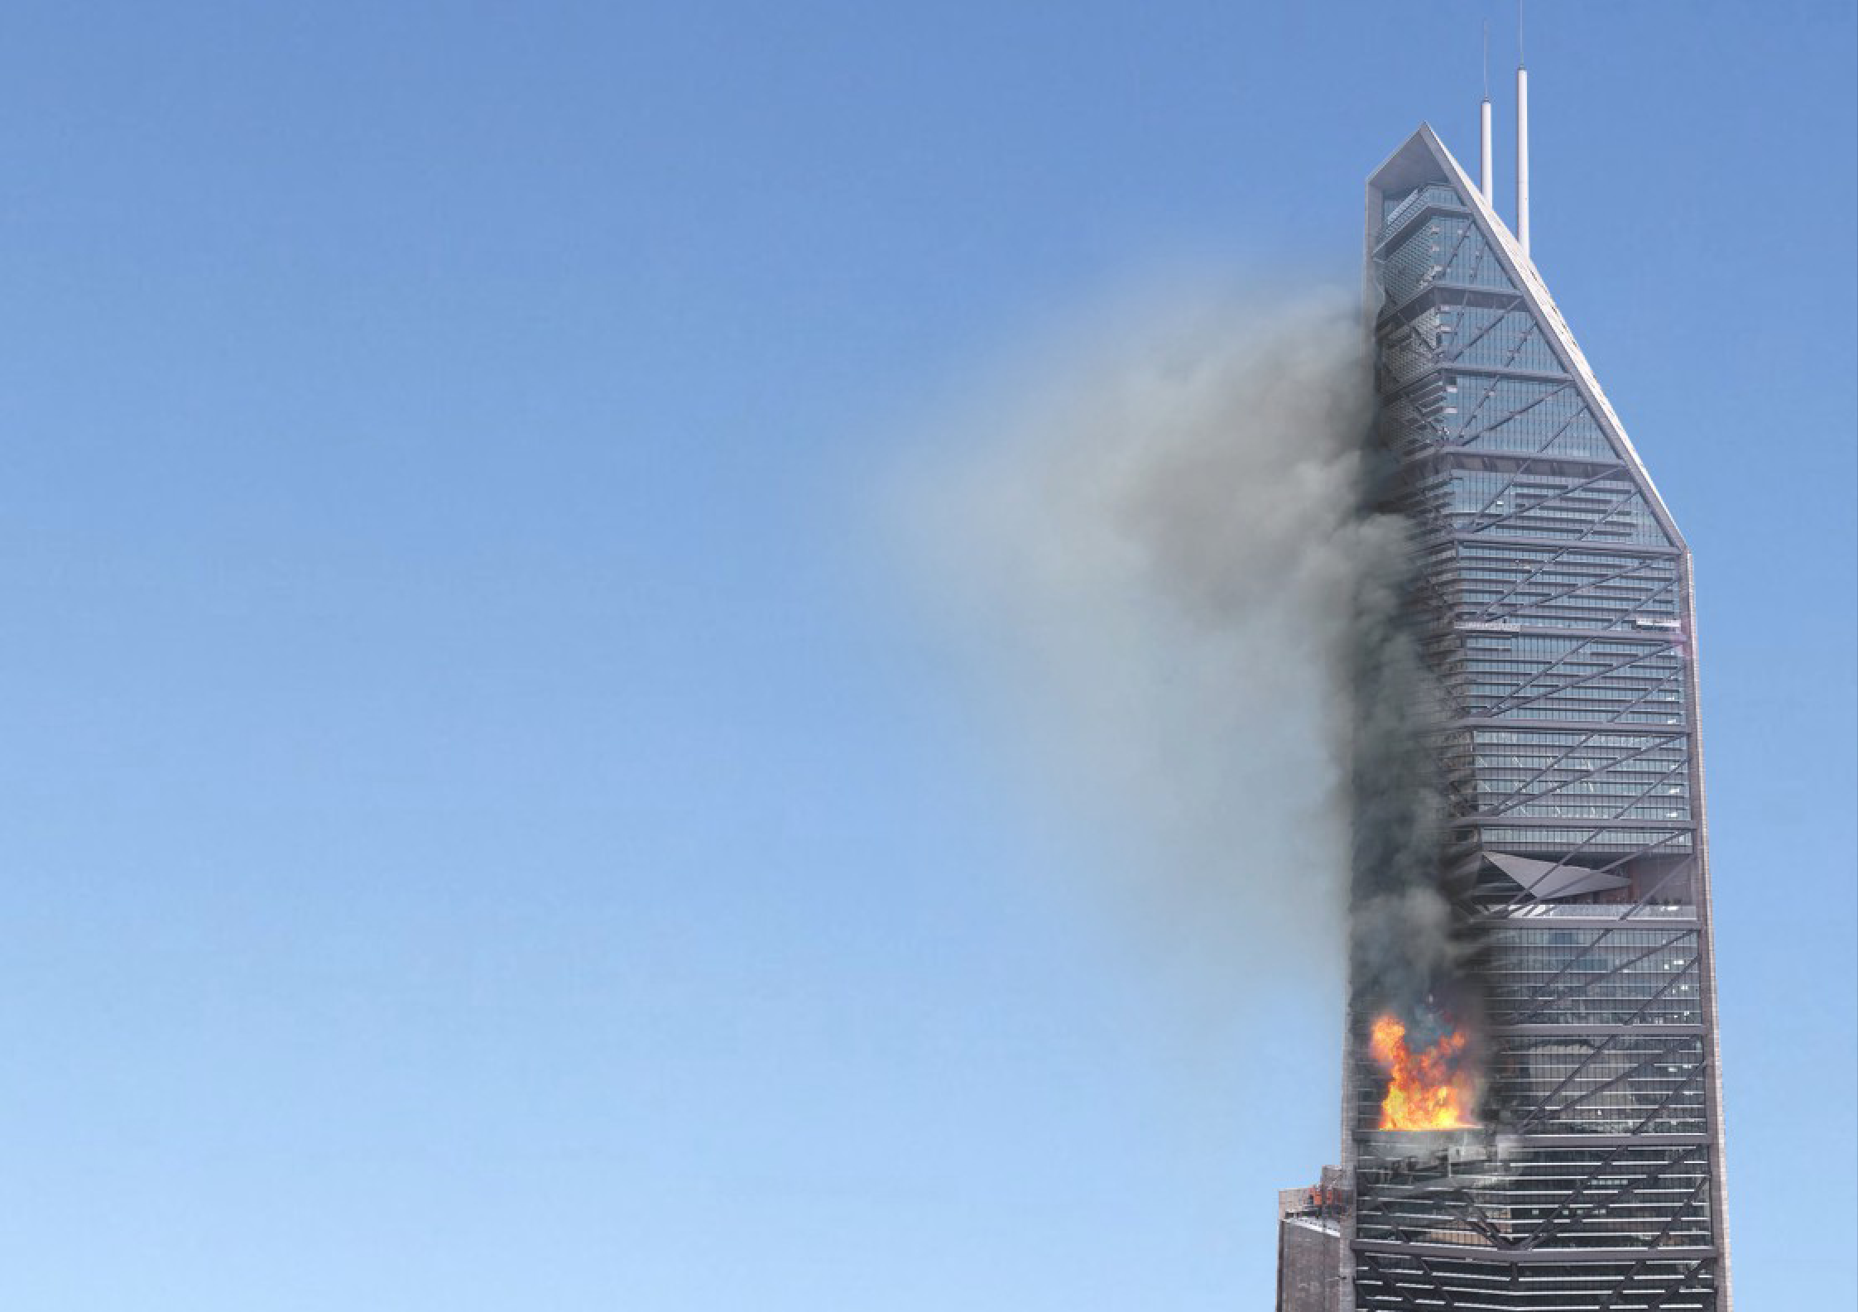







Slide 4

CONTACT US FOR YOUR SAFETY.
SAADAHANA HEALTH AND SAFETY SOLUTIONS
F2,Akshya flats, 19 Ramnagar First Main Road, Peravallur.
Chennai – 600082.
Mobile:7338880770
:9841300243
Mail id-saadhanatraining@gmail.com
K.PRAKASH
DIRECTOR TRAINING.

Slide 5

Level 3 Award in ESG Leadership Environmental, Social and Governance (ESG)

Slide 6
Environmental, Social, and Governance (ESG) courses are important in India because they help businesses understand and address environmental and social issues, and become more sustainable: Understand issues ESG courses help businesses understand the impact of their operations on the environment, human rights, diversity, and community engagement. Improve sustainability ESG courses help businesses improve their long-term sustainability and meet stakeholder expectations. Reduce risk ESG courses help businesses identify and mitigate risks related to environmental, social, and governance issues. Improve access to capital ESG courses help businesses improve their access to capital. Transform operations ESG courses help businesses transform how they operate to become more sustainable.

Slide 7
AOSH UK is a progressive and fast-growing autonomous certification body, our purpose is to certify practitioners in the health and safety profession. AOSH Certification Schemes are accredited by International Accredited Service (IAS) as per ISO/IEC/17024:2012 standard.

Slide 8


Slide 9
TRAINER
K.Vengatesan B.Tech ,MBA,I Dip Nebosh, ADIS, ADHSE, Grad IOSH
Manager (HSE),Suzlon Energy Limited,
HSE & ESG Consultant – Oil& Gas, Refinery & Manufacturing Units
Lead HSE Engineer- ADNOC Projects- Abu-Dhabi
Safety Engineer -SABIC-Saudi Arabia
IRCA- Approved Trainer
ESG Trainer & Consultant
Chennai Metro(CMRL) Approved Trainer & Auditor
IOSH & NEBOSH-Trainer and Examiner
NLC Approved Trainer
IOCL Approved Trainer
Southern Railways trainer and Consultant

Slide 10
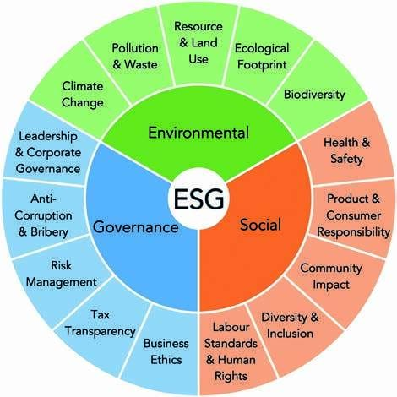

Slide 11
Theme for National Safety Day/Week 2024:
“Focus on Safety Leadership for ESG Excellence” The theme for National Safety Day/Week 2024, “Focus on Safety Leadership for ESG Excellence,” underscores the strategic integration of safety practices with Environmental, Social, and Governance (ESG) principles

Slide 12
Environment

Slide 13
Climate Change

Slide 14


Slide 15


Slide 16
Pollution and Waste

Slide 17


Slide 18



Slide 19
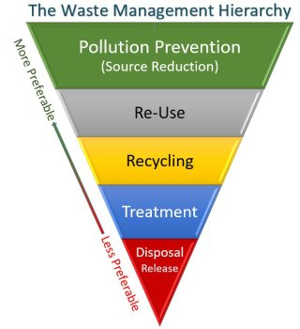

Slide 20
Natural Resource and Land Use

Slide 21
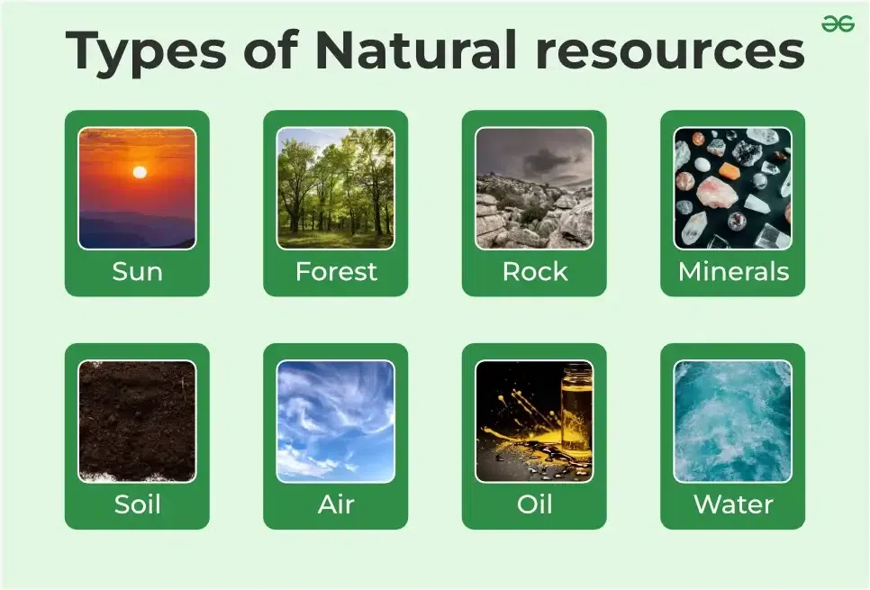

Slide 22
Ecological Footprint

Slide 23
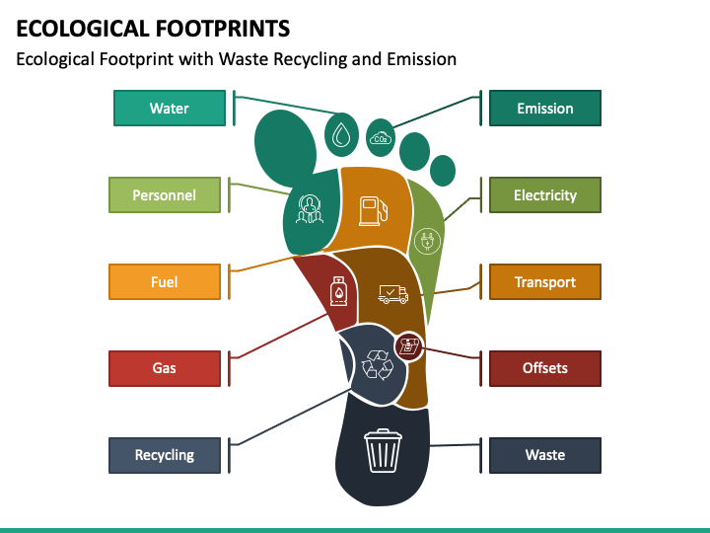
It is a measure that indicates how much resources from the environment are required to support a specific way of life or business.

Slide 24
Biodiversity

Slide 25


Slide 26
SOCIAL

Slide 27
Health & Safety

Slide 28


Slide 29


Slide 30
Product & Consumer Responsibility

Slide 31

They should be aware of the price, manufacturing and expiry date, net weight, and so on. A consumer should always look for standardised products as they ensure the best-in-class quality. These include the ISI mark, Hallmark & etc

Slide 32
Community Impact

Slide 33


Slide 34
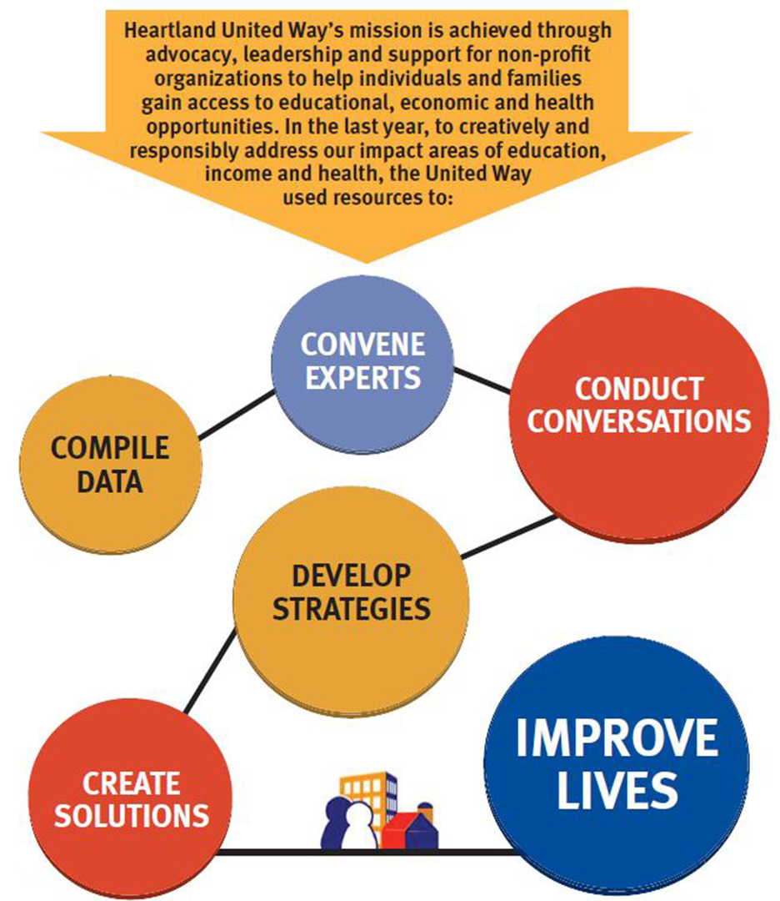

Slide 35
Diversity & Inclusion

Slide 36


Slide 37


Slide 38
Labour Standards & Human Rights

Slide 39


Slide 40


Slide 41
GOVERNANCE

Slide 42
Business Ethics

Slide 43


Slide 44


Slide 45
Tax Transparency

Slide 46


Slide 47


Slide 48
Risk Management

Slide 49
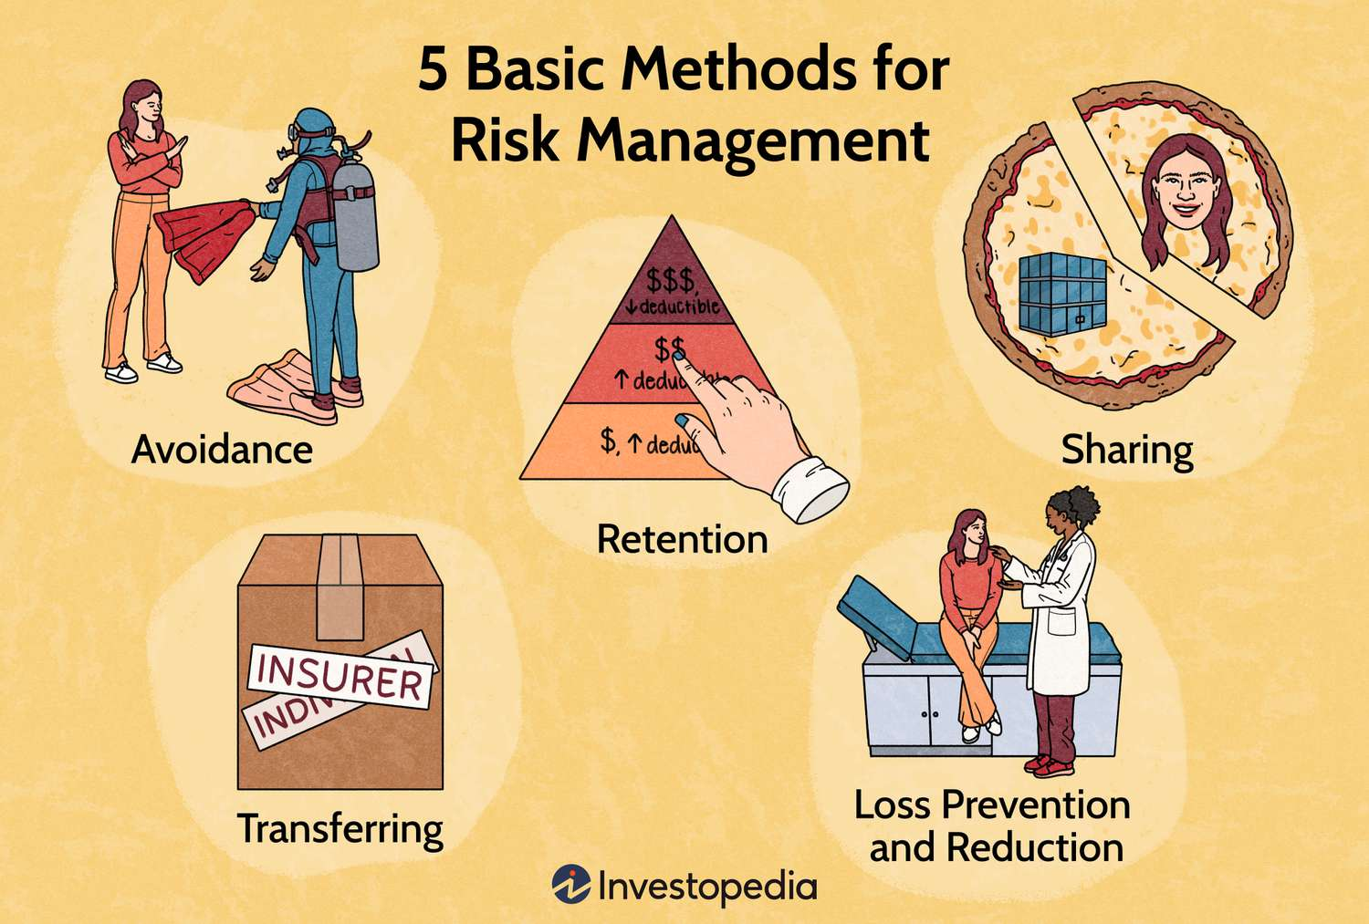

Slide 50


Slide 51
Anti Corruption & Bribery

Slide 52


Slide 53


Slide 54
Leadership & Corporate Governance

Slide 55
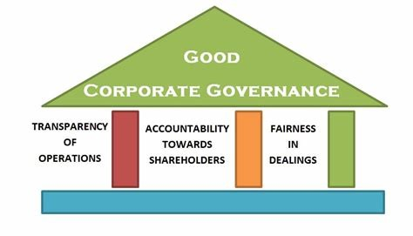

Slide 56


Slide 57
Thanks

